Slide 1
Week 2: Practice makes perfect

Slide 2
Agenda
Recap of last week’s session: Project Mindset vs Product Mindset, Product failure, Product teams Being Agile: Values of Agile
Scrum and Kanban: Agile methods in practice
Mock Project: Experiential learning

Slide 3
Recap of last week’s session
Project Mindset vs Product Mindset
Product failure
Product teams

Slide 4
Products fail when . . .
Stakeholders drive the ideation, discovery, prioritization and execution, rather than user needs
There’s no team alignment on ‘why’ a product is being built
Teams are siloed and sparsely communicate
Teams obsess over ‘Plan, finalize and execute’, rather than user needs and pains
There’s complete outsourcing, noone in-house involved
Measures of success are about ‘delivering a product on time and under budget’, rather than value for users
Notes:
We spoke of a few common reasons why products fail - waterfall being a reason for these failures

Slide 5
Integrated product team
Product management
Requirement gathering
High level communication
Roadmapping
Prioritization of tasks and issues
Backlog management
Stakeholder management
Product management
Design
User experience (UX)
Research
Interaction design
Visual design
Content design
Usability testing
Design
Development
Development
Development
Security
Platform decisions
Constraints
Testing
Devops
Notes:
We spoke of cross functional teams and the role of a product owner

Slide 6
Being Agile

Slide 7
Agile: a set of principles
Scrum: a set of roles and meetings that implement Agile

Slide 8
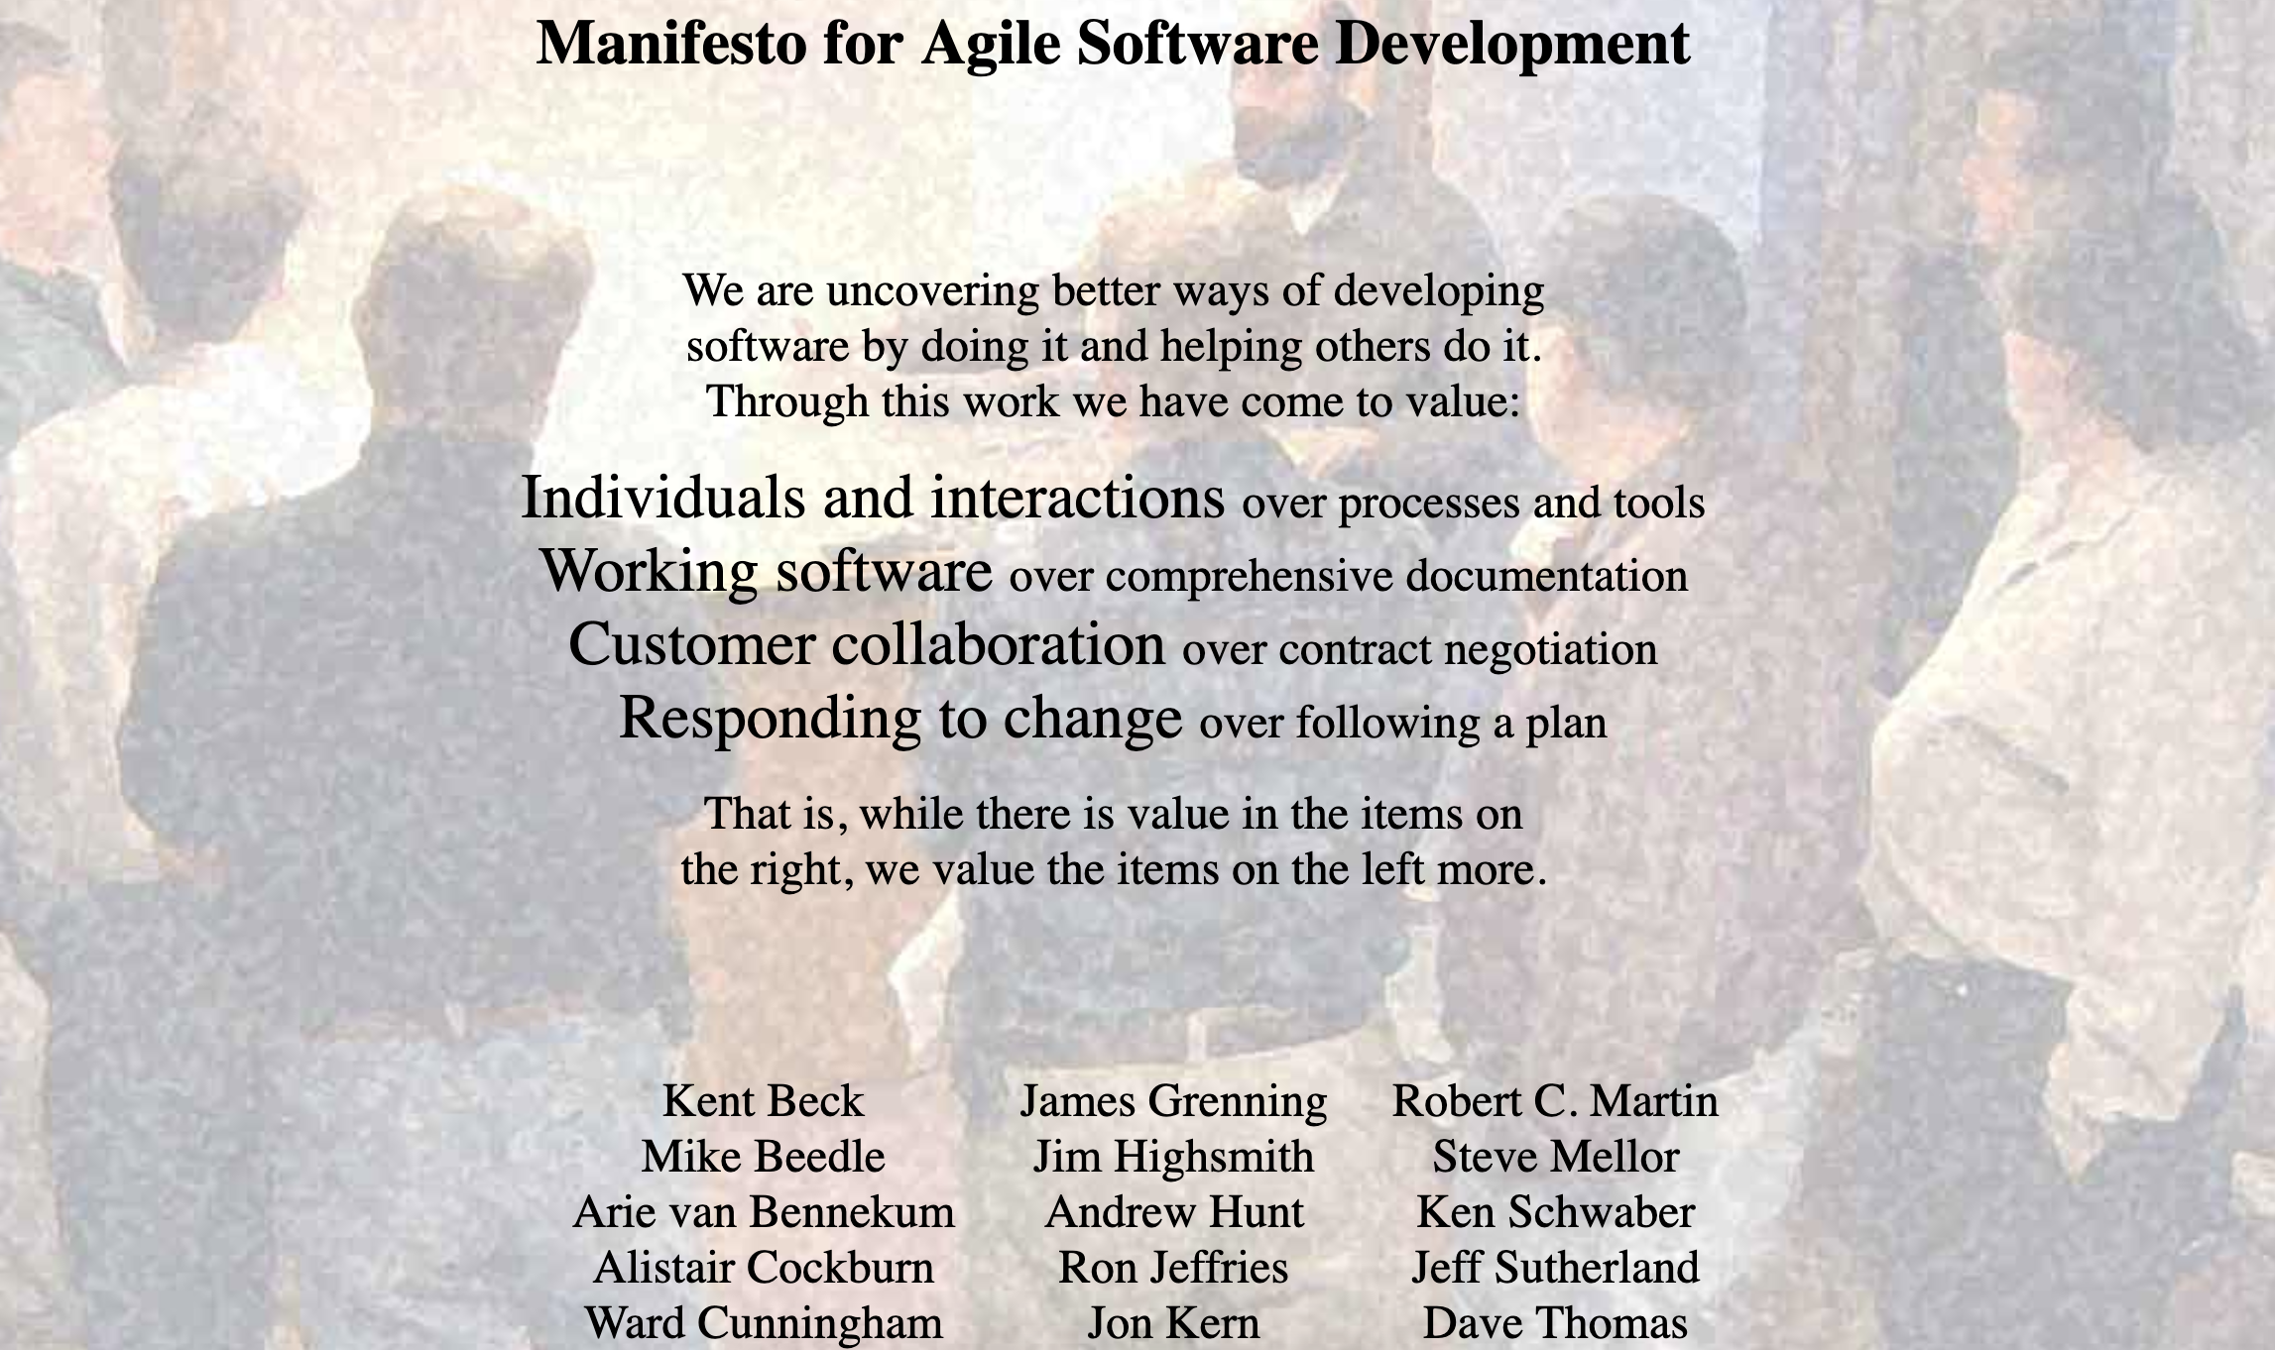
Agile Manifesto
https://agilemanifesto.org
Notes:
So then in 2001 some forward-thinkers got together and wrote down their observations principles for healthy teams oriented towards delivering value. It’s revolutionary and its consequences are still unfolding.

Slide 9
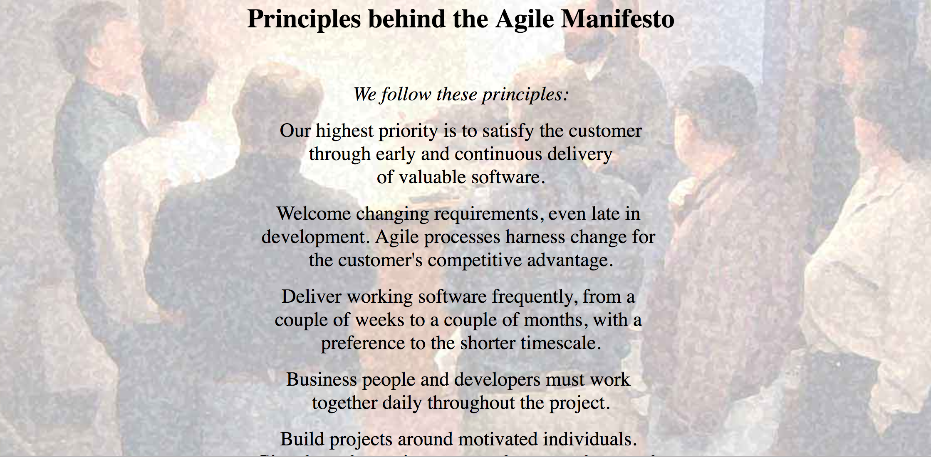
Agile Manifesto
https://agilemanifesto.org
/principles.html
Notes:
So then in 2001 some forward-thinkers got together and wrote down their observations principles for healthy teams oriented towards delivering value. It’s revolutionary and its consequences are still unfolding.

Slide 10
Individuals and interactions over processes and tools
Working software over comprehensive documentation
Customer collaboration over contract negotiations
Responding to change over following a plan
AGILE MANIFESTO - KEY TAKEAWAYS

Slide 11
Agile values

Slide 12
AGILE VALUES
Customer satisfaction
Frequent delivery
Welcoming change
Working software
Technical and design excellence
Simplicity
Cross-functional teams
Self-organizing teams
Reflecting frequently

Slide 13
Customer satisfaction
Getting a working software to users early.
Notes:
minimum viable products and experimentation to test hypothesis and validate ideas.
Frequent releases for continuous feedback cycle

Slide 14
Frequent delivery
Develop products in smaller increments and focus on delivering (“shipping”) often.
Notes:
“sprints” break down initiatives into smaller chunks that can be completed in a set timeframe.
creates more opportunities for you and your teams to validate your ideas and strategies

Slide 15
Welcoming change
Focus on constantly learning customer needs, emerging markets, and adapting to changes vs following a plan.
Notes:
guided by high-level strategic goals.
Product constantly has its ear to the ground monitoring the market, customer feedback, and other factors which could influence product direction. When actionable insight is uncovered, plans are adjusted to better serve customer and business needs.
As such, product needs to manage the expectations of executive stakeholders appropriately and ensure they understand the why behind changes.

Slide 16
Working software
Measure success by working software delivered vs detailed documentation (“it’s not done until it’s perfect” mindset).
Notes:
Ship software often: a useful product now is better than a perfect one later
thinking first and foremost about the smallest things we can ship to start getting customer feedback and validate as we continue to build software.
A fail fast mentality means moving forward even in times of uncertainty and testing ideas rapidly.

Slide 17
Technical and design excellence
Maintain a balance between delivering to customer needs and managing tech and design debt.
Notes:
Developers and product need to work together to understand if and when technical debt is acceptable.
On a regular basis, product will need to allocate development resources to refactoring efforts.
Refactoring cannot be an afterthought, it needs to be an ongoing consideration.

Slide 18
Simplicity
Prioritize ruthlessly. Balance work done with work not done.
Notes:
being extremely picky about what user stories and features actually make the cut.
experiments to validate ideas before building them up to spec is a great way to weed out bad ideas and identify good ones.

Slide 19
Cross-functional teams
Business and technology teams (vendors included) consistently work in tandem to foster trust, transparency, communication and above all, alignment.

Slide 20
Self-organizing teams
Teams take responsibility and ownership in collaborating and making decisions to deliver value.
Notes:
Self-organizing teams are autonomous groups within the organization who take control and responsibility over their respective projects and have ownership of those areas.

Slide 21
Reflect frequently
Teams welcome feedback, openness, and blameless retrospectives to learn, improve, and foster trust.
Notes:
Agile teams are encouraged to experiment with their processes..
Team learns if they are communicating effectively with developers and giving them the support they need before, during, and after sprints.

Slide 22
Scrum and Kanban

Slide 23
Scrum and Kanban both methods to practice agility
Scrum helps you execute on your vision, goals, and intended outcomes.
Kanban helps you visualize work and focuses a team on finishing work.
Notes:
Scrum and Kanban are both methods to practice agility. They both deliver good results by themselves, but are amazing when we combine these.

Slide 24
Scrum

Slide 25
Scrum is an Agile framework to help you execute on your vision, goals, and intended outcomes.
Notes:
It should provide a starting point for communication and alignment so that you don’t have to invent processes.

Slide 26
Scrum delivery cycle
Prioritize
Plan
Build
Ship
Reflect
Team touches base daily to track status and remove blockers

Slide 27
SPRINTS
The start and end points for working periods are set by the length of the sprint
start
end
Notes:
Teams work in time-boxes called sprints.

Slide 28
A weekly sprint schedule might look like this...
EXAMPLE

Slide 29
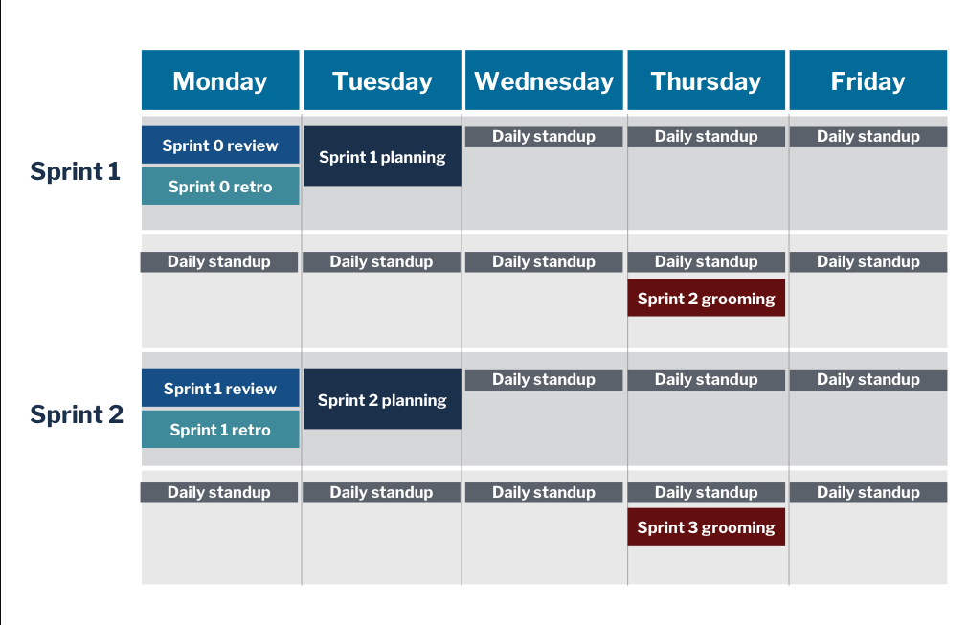
EXAMPLE

Slide 30
Prioritized product backlog
Before the sprint, the product owner prioritizes the work at a high level in the form of user stories with defined acceptance criteria.
PREREQUISITE - GROOMED BACKLOG
Notes:
These stories are prioritized, generally to give the most value earliest.
Acceptance Criteria

Slide 31
Backlog refinement or “grooming”
Purpose Ensure an always “ready” product backlog
What happens Team collaboratively updates the product backlog via reprioritization, adding/deleting/rewriting stories, splitting, and estimating
Duration Can be a regular recurring meeting or scheduled as needed
Outputs A healthy, “ready” product backlog
Notes:
This can be a regular recurring meeting, but is not a standard part of Scrum. Backlog refinement activities can also happen outside of a formal meeting. The Product Manager should be regularly working to refine the backlog, update issues, write acceptance criteria and user stories, prioritize them.

Slide 32
PREREQUISITE - GROOMED PRODUCT BACKLOG
Product backlog

Slide 33
Plan
The prioritized work is then negotiated, agreed upon, and sometimes broken down further into smaller pieces of work. Stories prioritized and agreed upon by the product team then form the sprint backlog.

Slide 34
Sprint planning
Purpose Review the prioritized product backlog and negotiate a sprint backlog
What happens Product manager (PM) brings a prioritized product backlog with “ready” user stories; team asks questions to understand acceptance criteria; team and PM negotiate a sprint backlog
Duration ~2 hours for a 2-week sprint
Outputs
Sprint goals
Sprint backlog
Notes:
Product Manager can help set this meeting up for success. PM’s job during this meeting is to provide a clear list of priorities, answer the team’s questions, and “negotiate” with the team about what can go into the sprint backlog. These go better if the backlog is healthy - prioritized, and including acceptance tests, dependencies, estimates, diagrams or screenshots (if applicable), etc.
This is where the team commits to the amount of work they will complete. It must be achievable. If you finish earlier and add more tasks, that’s great, but if you are consistently not finishing the work that you commit to, the team is over estimating and needs to figure out what’s the dilly with their planning.
Can start this meeting by looking at team’s capacity (availability -- vacations, holidays etc.) and velocity (how fast the team is finishing things, as a team gels and works together, they tend to increase their velocity).

Slide 35
SPRINT BACKLOG
Sprint Backlog

Slide 36
Build
During the sprint, product teams work only on those stories and check in daily to retain focus and unblock each other.

Slide 37
Daily standup
Purpose To surface and remove obstacles
What happens Each team member answers:
What did you do yesterday?
What will you do today?
Are there any obstacles in the way?
Duration Not more than 15 minutes daily
Outputs
List of obstacles to remove
Potential list of more in-depth conversations to have
Notes:
This is not a status update meeting! It’s about team coordination and assessing blockers and risks.
Scrum Master can serve as a timekeeper - identify issues that warrant further discussion, and encourage team to sync up soon after (sidebars or other topics)
A couple times a week after our standup we have co-working time scheduled where we frequently will dive into issues more deeply after the check in.

Slide 38
to-do
P1
P2
P3

Slide 39
to-do
P1
P2
P3
✔

Slide 40
to-do
P1
P2
P3
✔
✔
✔
✔

Slide 41
Ship
At the end of the sprint, all delivered work is reviewed by the product team and stakeholders to decide whether it’s “done.” If it’s code, this may mean it can go to production; if it’s a research question, this may mean that it’s answered.

Slide 42
Sprint review or “Demo”
Purpose Showcase completed work to stakeholders and build buy-in
What happens Team demonstrates completed work to stakeholders and users
Duration ~1 hour
Outputs Actionable feedback from stakeholders and users
Notes:
Preparing for this meeting is a good idea! Invite all the stakeholders! Share out the info! This is our chance to check in and make sure we’re on the right track (and if not, course correct for the next sprint)
Since stakeholders from outside the scrum team are often in attendance, be sure to build in any rehearsal time or other preparation necessary to set the team up for success.
Focus the Sprint Review around user experience and business value. It should not feel like the Development Team is just proving that things work.
The Product Manager should be asking questions to the stakeholders, gathering feedback, and also providing answers to any that arise.

Slide 43
SPRINT BACKLOG
to-do
✔
✔
✔
✘
✔
P1
P2
P3
✔
✔
✔
✔
✔
✔
✔
✔
✘
✔
✔
✘
✘

Slide 44
UNFINISHED ITEMS FROM THE SPRINT BACKLOG
to-do
✔
✔
✔
✔
P1
P2
P3
✔
✔
✔
✔
✔
✔
✔
✔
✔
✔
✘
✘
✘
✘

Slide 45
SHIPPED INCREMENT
to-do
done
✔
✔
✔
✔
✔
✔
✔

Slide 46
Reflect At the end of the sprint, we take time to reflect on how we can better fulfill our mission through process improvements or by responding to feedback.
Notes:
We have retrospectives, and we gather data from users, or our impact measures so that we can track our progress

Slide 47
Sprint retrospective
Purpose Team reflects and can adjust practices as needed
What happens Team reflects on what worked during the sprint (from a process perspective) and what could be improved
Duration ~1 hour
Outputs Process experiments to try
Notes:
No stakeholders in this meeting; it’s for the team only
Candid; Blameless.
The format can change to keep things from becoming rote; there’s always an opportunity for continuous improvement
Generate meaningful insights from the conversation, and aim to agree upon a few process changes to experiment.

Slide 48
Kanban

Slide 49
Kanban is an alternative Agile method that focuses on improving efficiency and flow aka a team not accepting new work until they finish their work on hand.

Slide 50
Kanban helps teams visualizes all their work.

Slide 51
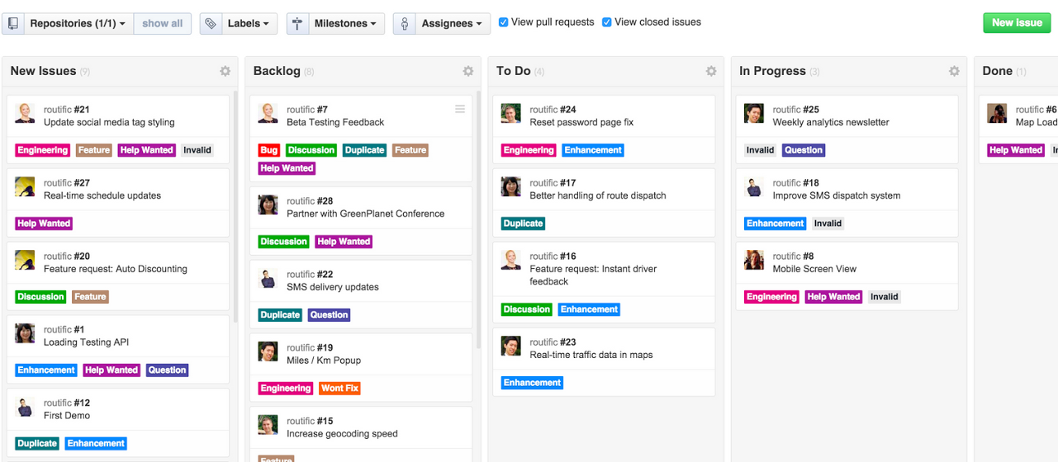
Sample Kanban Board
Notes:
All teams collaborating and working together on the same problem. Product management setting priorities and organizing teams. - Using Kanban boards and backlogs to move forward

Slide 52
Kanban works well for repetitive, well-defined tasks.

Slide 53
In Kanban, the product team limits work in progress (WIP) to ensure that WIP reaches completion before any new work is accepted. This is known as setting “WIP limits.”

Slide 54
Example to show WIP in a board and WIP limits

Slide 55
Scrum + Kanban

Slide 56
Daily standups (Scrum)
Continuous prioritization (Kanban)
Biweekly retrospectives (Scrum)
Sprint reviews with partner (Scrum)
WIP limits (Kanban)

Slide 57
One more thing...

Slide 58
Scrum ≠ Agile
Following the scrum ceremonies is not enough to make a team “agile.”
Agile is about:
Iterative development
Continuous delivery
Continuous improvement

Slide 59
‘Mock’ Project

Slide 60
Project details
What we’re planning to do: Redesign AMPD
Why a ‘mock’ project:
To practice the lessons and principles we’re learning and experience them first-hand
To gain confidence to lead with a product mindset when the vendor is on board
Simulate scenarios for the teams to react to
What we’re not trying to do:
Have a design or an MVP ready for the vendor to execute
Aim for a finished product
Repeat exercises we’ve conducted in the past (visioning, personas, etc.)

Slide 61
Cross-functional product team
Product owners
Jason and Joe K
Subject matter experts
Craig, Chris, Mike H
Acq and project management
Kim and Laurie
Engineering
Mike, Joe T, Thuy
Strategy/Design/UX
Andrew, Garrett, Michelle

Slide 62
Getting started on our project
Project name:
Scrum master:
Sprint cadence:
Sprint Planning:
Daily stand up:
Sprint review
Sprint retro:
Kanban board:
Team charter:

Slide 63
Thank you!

